Slide 1



Slide 2


Slide 3

Who are LRN?
Learning Resource Network (LRN) is accredited as an Awarding Body by the Office of Qualifications and Examinations Regulation (OFQUAL) in the United Kingdom.

Slide 4
What do we provide?
We offer internationally recognised examinations in:
English for Speakers of Other Languages(ESOL)
Business
Teaching

Slide 5

Where in the World?
We have:
150 test centres in
58 countries

Slide 6
What do our qualifications offer?
Our qualifications can help students to:
get a better job
study in another country
demonstrate their personal progress using an international standard

Slide 7

LRN ESOL International
Why use an exam in Spoken English?

Slide 8
Firstly: Why speak and understand English?
You can be one of the other 341,000,000 people who do!
Language | Native Speakers
Mandarin | 874,000,000
Hindi | 366,000,000
English | 341,000,000
Spanish | 322,000,000
Bengali | 207,000,000

Slide 9

Learning English
Skills
Listen
Read
Write
Speak

Slide 10
Learning English
LRN ESOL International Qualifications are based around the four components:
Speaking
Listening
Reading
Writing

Slide 11
Levels
Level group name | CEFR Level
Basic User | A1 & A2
Independent User | B1 & B2
Proficient User | C1 & C2

Slide 12

Why does Speaking and Listening Matter?

Slide 13
Speaking and Listening
Speaking and listening are important for learners for a number of reasons:
Spoken language is at the heart of much human interaction, at home, at work and in society.
Speaking and listening skills are important in all contexts in which learning takes place, whether it be family literacy, language and numeracy.
Good speaking and listening skills are a key aspect of employability: getting a job, maintaining employment and progressing at work.
Good oral communication skills are important in other aspects of learners’ wider lives, such as in family and peer relationships or when communicating with the school over children’s education.
Purposeful use of speaking and listening is central to effective teaching and learning.

Slide 14
ESOL International
LRN spoken exam is a 1-to-1 conversation between the candidate(s) and an examiner.
The exam lasts around 15 minutes.
The genuine interaction measures fluency, accuracy and communication skills.

Slide 15
Reading
"Research findings in applied linguistics and reading research consistently show a strong correlation between reading proficiency and academic success at all ages, from the primary school right through to university level: students who read a lot and who understand what they read usually attain good grades.”

Slide 16

Reading

Slide 17
Writing
Writing enhances language acquisition as learners experiment with words, sentences, and larger chunks of writing to communicate their ideas effectively and to reinforce the grammar and vocabulary they are learning in class
(Bello, 1997)

Slide 18
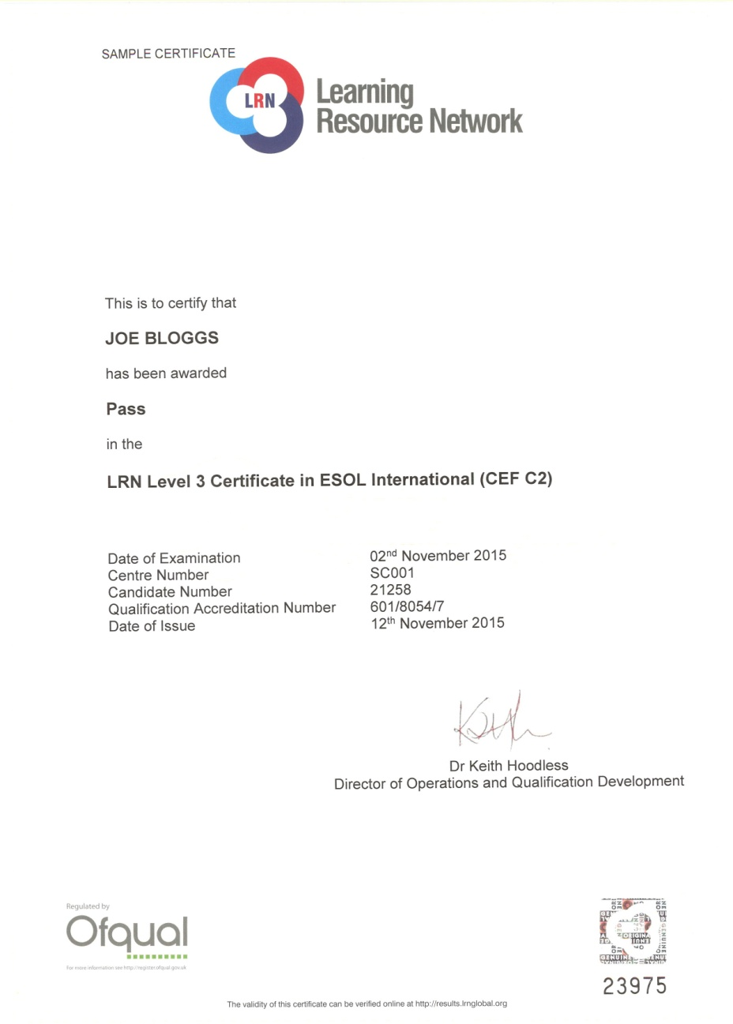

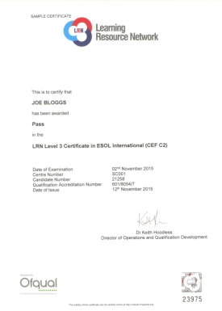
Recognition and levels

Slide 19

What are the needs of your staff? Which language skills do they MOST need to improve?
Reading & Writing? OR Listening & Speaking?
What should be the FOCUS of your English course?

Slide 20

Washback
The focus of your exam will WASHBACK into the lessons.
Writing exam = lots of past papers and writing practice
Speaking exam – lots of interaction and speaking practice

Slide 21
Government Recognition
The Office of Qualifications and Examinations Regulation (OFQUAL)
Maritime & Coastguard Agency, UK
ASEP Greece
Ministry of Education, Italy (MIUR)
NEAS, Australia
Malta Qualifications Recognition Information Centre (MQRIC)
Ministry of Education & Science, Lithuania
CRUE Spain
Ministry of Education & Science, Romania
KHDA, Dubai

Slide 22

Affiliations & Memberships
Association of Language Testers in Europe (ALTE)
English UK
ISO 9001:2015 Certified
EALTA Institutional Member

Slide 23


Slide 24
Benefits
Exam focused on communication
Your teachers will focus the English course on Listening and Speaking skills
Your staff will become more skilled and confident using English to communicate with others
Friendly, non-threatening, enjoyable!

Slide 25

For more information, please visit www.lrnglobal.org
or contact us at
enquiries@lrnglobal.org

